Slide 1
HIT140 FOUNDATIONS OF DATA SCIENCE
Assessment 2: Group Project Presentation
Pranjol Koirala (s382898)
Komalpreet Kaur(s377793)
Li Yue(s382597)

Slide 2
INTRODUCTION
In this presentation, we will discuss the relationship between
demographic factors,
technology use (screen time),
and well-being among adolescents
base on Descriptive Statistical Analysis and Inferential Statistical Analysis.
At the end, we will come to an conclusion based on the our research.

Slide 3
Descriptive Statistics
Descriptive statistics help summarize large amounts of data in a meaningful way. Common measures include:
Measures of Central Tendency: such as mean (average), median (middle value), and mode (most frequent value), which describe the center of the data.
Measures of Variability: such as range, variance, and standard deviation, which show how spread out or clustered the data points are.
Data Distribution: can also be visualized using histograms, pie charts, or box plots to identify trends, patterns, and outliers in the dataset.

Slide 4
Inferential Statistics
Inferential statistics go beyond the data at hand, allowing us to make predictions and generalizations about a population. Key techniques include:
Hypothesis Testing: determining if a result is statistically significant, typically using p-values to accept or reject a null hypothesis.
Confidence Intervals: estimating the range within which a population parameter (like the mean) lies with a certain degree of confidence.
Regression Analysis: examining relationships between variables to make predictions about future outcomes or trends.
Sampling Methods: using random samples from a population to infer conclusions while accounting for the potential of sampling error.

Slide 5
DATA ANALYSIS

Slide 6
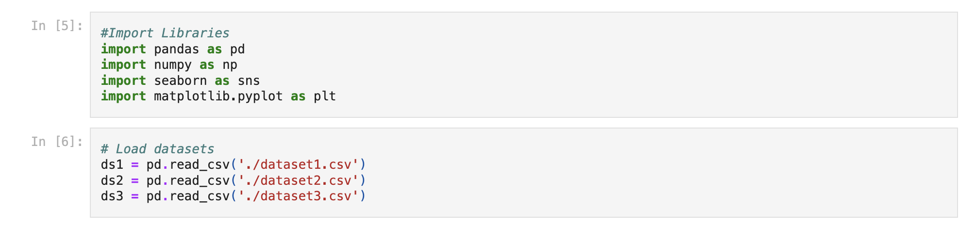
To analyze the dataset,
the three given datasets were imported;
the column names were derived;
and the datasets were merged together.

Slide 7
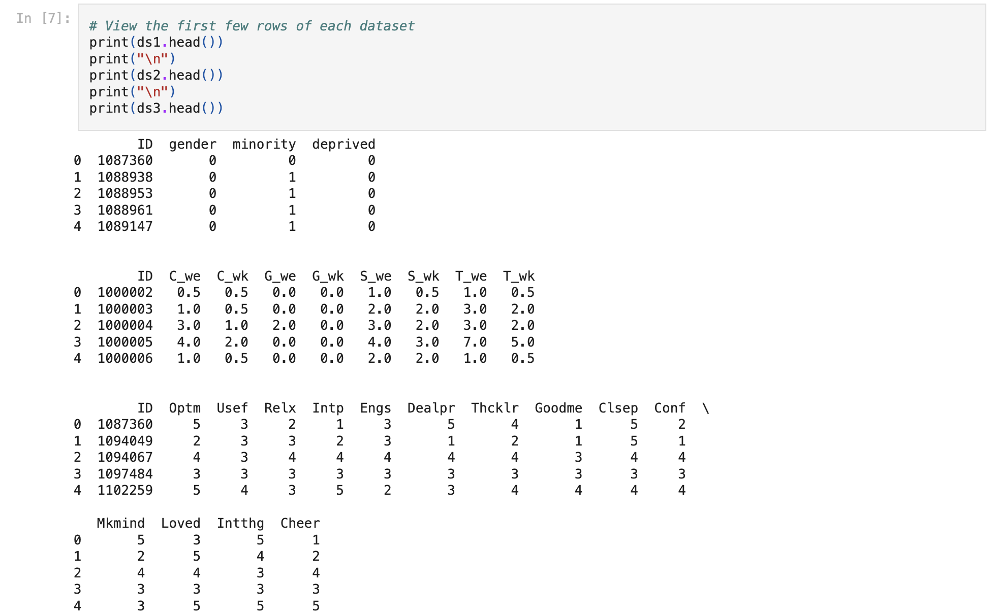
Notes:
Dataset 1 contains basic demographic information of more than 120,000 adolescent respondents, each person identified by a unique ID number.
Dataset 2 shows the watchtime for the person by the ID from dataset 1.
Dataset 3 provide well being score for the individual in some categories.
All of those three data sets have ID column, which is the connection for all those datasets

Slide 8
Dataset 1 contains basic demographic information of more than 120,000 adolescent respondents, each person identified by a unique ID number.
ID: A unique number identifying a respondent
gender: Self-reported gender (1 for male and 0 otherwise)
minority: 0 as belonging to the majority ethnic group of the country; 1 otherwise
deprived: 1 as residing in localities with high deprivation indices i.e. an area with high scores on unemployment, crime, poor public services, and barriers to housing etc.; 0 otherwise
Dataset 2 shows the watchtime for the person by the ID from dataset 1
ID (A unique number identifying a respondent),
C_we (Number of hours using computers per day on weekends),
C_wk (Number of hours using computers per day on weekdays),
G_we (Number of hours playing video games per day on weekends),
G_wk (Number of hours playing video games per day on weekdays),
S_we (Number of hours using a smartphone per day on weekends),
S_wk (Number of hours using a smartphone per day on weekdays),
T_we (Number of hours watching TV per day on weekends),
T_wk (Number of hours watching TV per day on weekdays);
Dataset 3 provide well being score for the individual in some categories.
ID (A unique number identifying a respondent),
Optm (I have been feeling optimistic about the future),
Usef (I have been feeling useful),
Relx (I have been feeling relaxed),
Intp (I have been feeling interested in other people),
Engs (I have had the energy to spare),
Dealpr (I have been dealing with problems well),
Thkclr (I have been thinking clearly),
Goodme (I have been feeling good about myself),
Clsep (I have been feeling close to other people),
Conf (I have been feeling confident),
Mkmind (I have been able to make up my own mind about things),
Loved (I have been feeling loved),
Intthg (I have been interested in new things),
Cheer (I have been feeling cheerful);

Slide 9
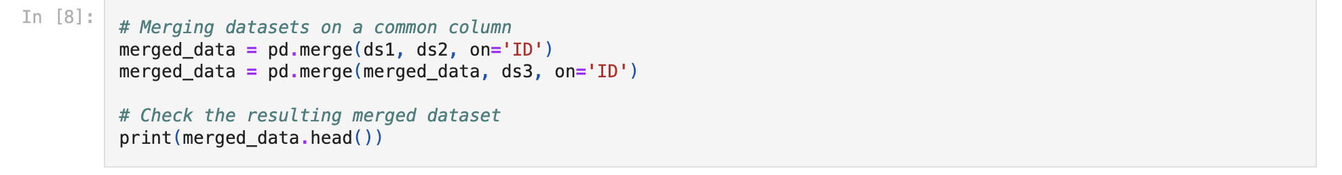
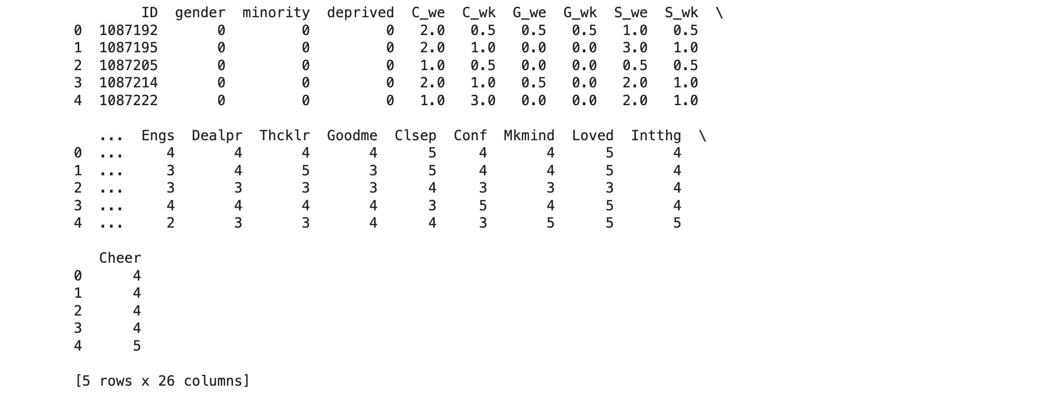

Slide 10
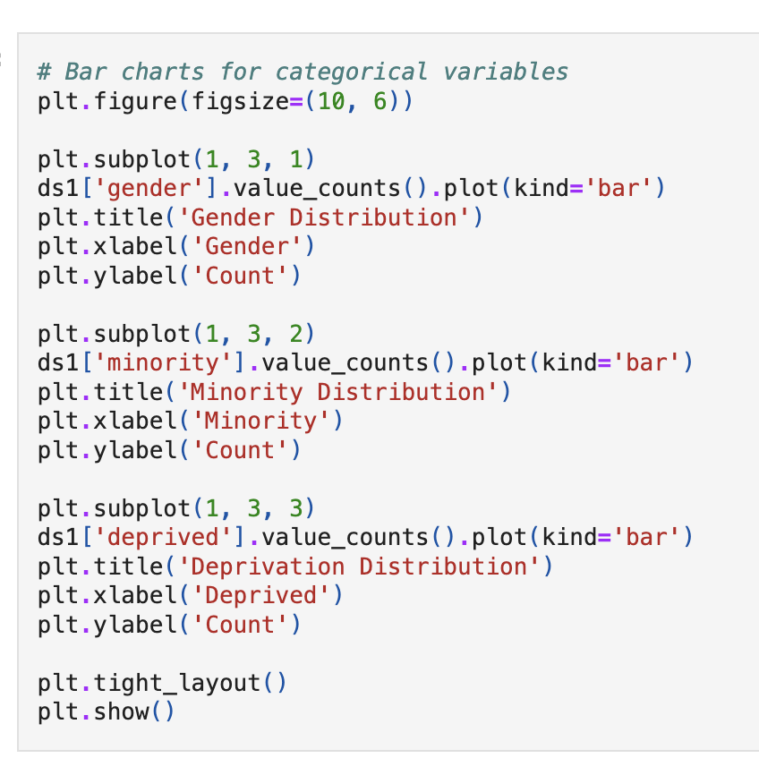
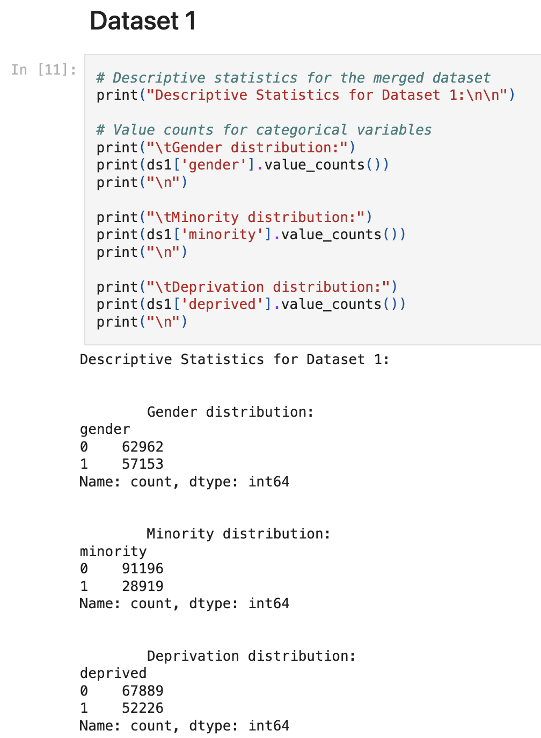
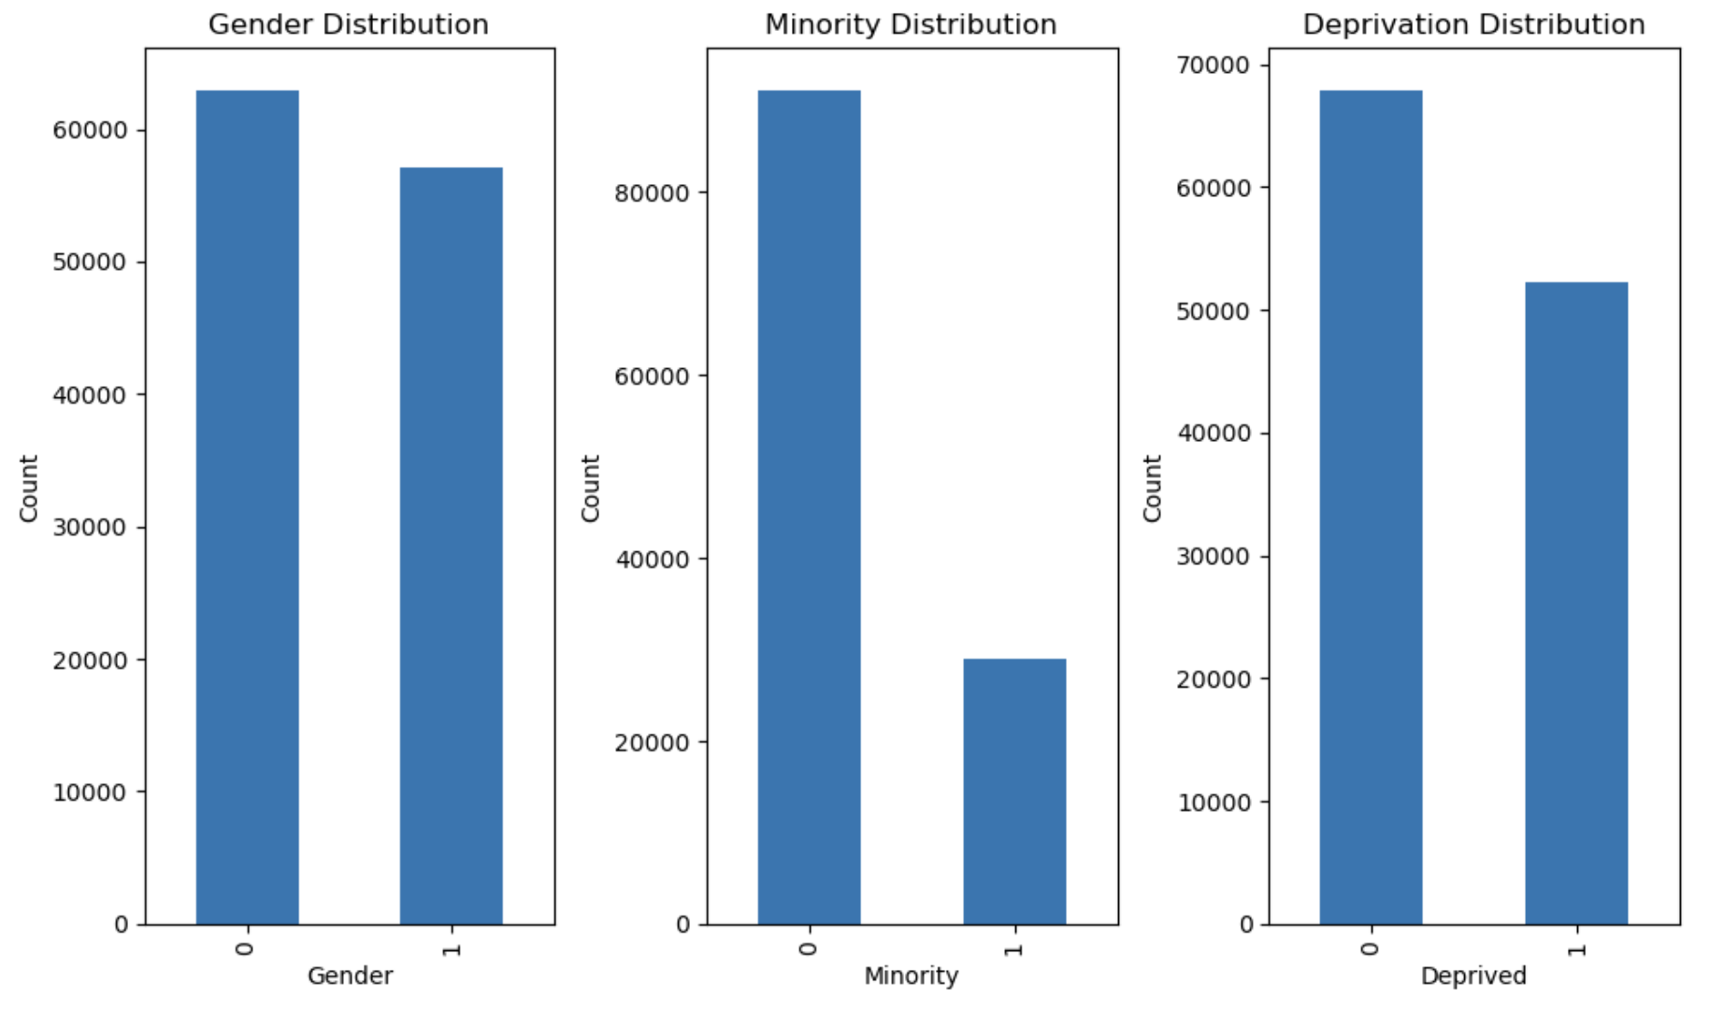
Descriptive Statistical Analysis

Slide 11
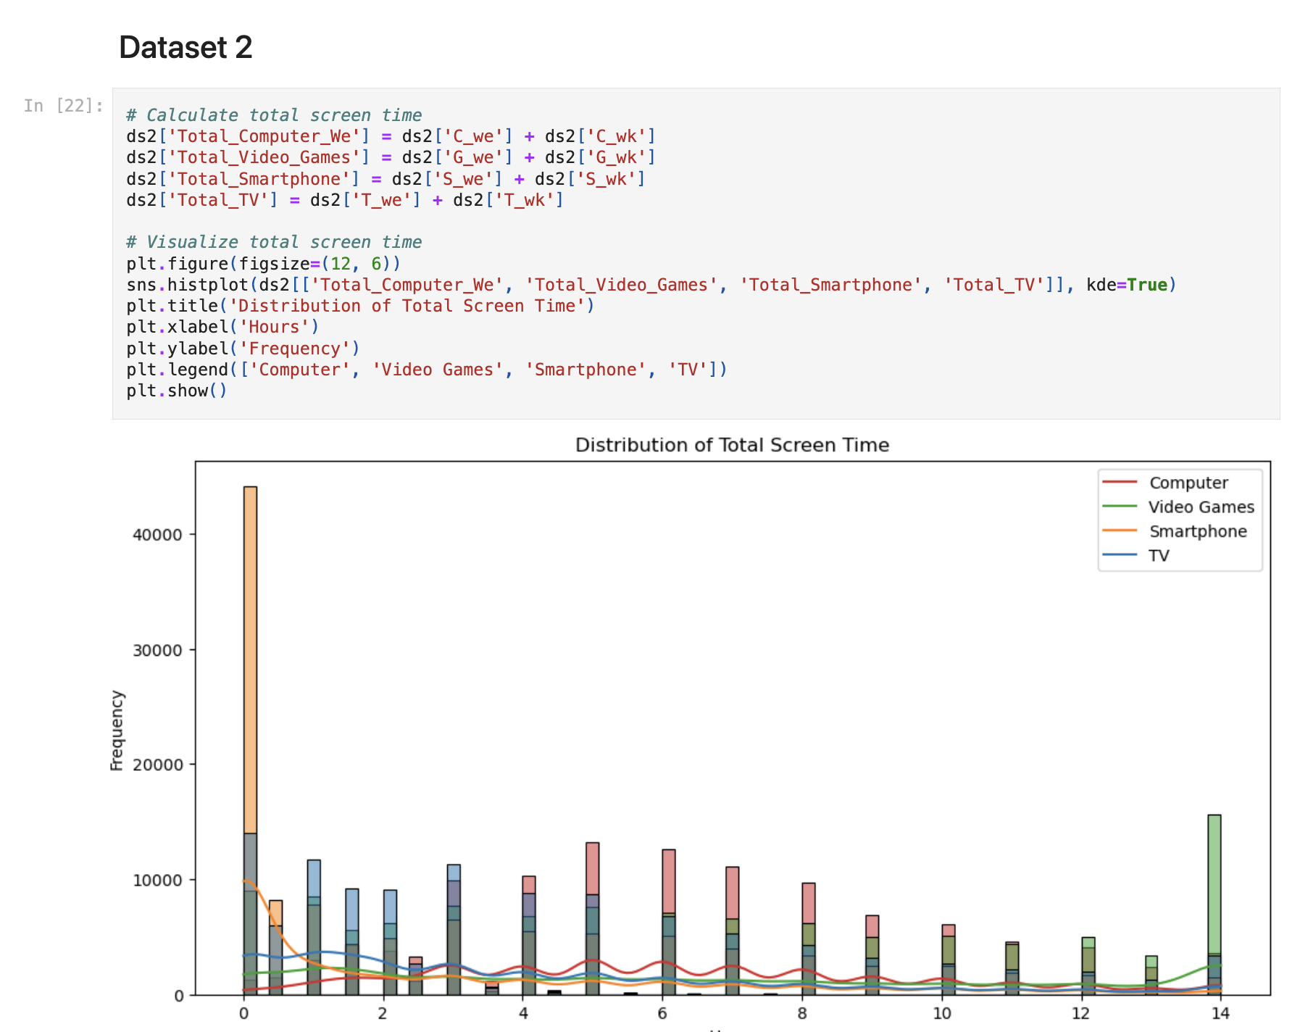

Slide 12
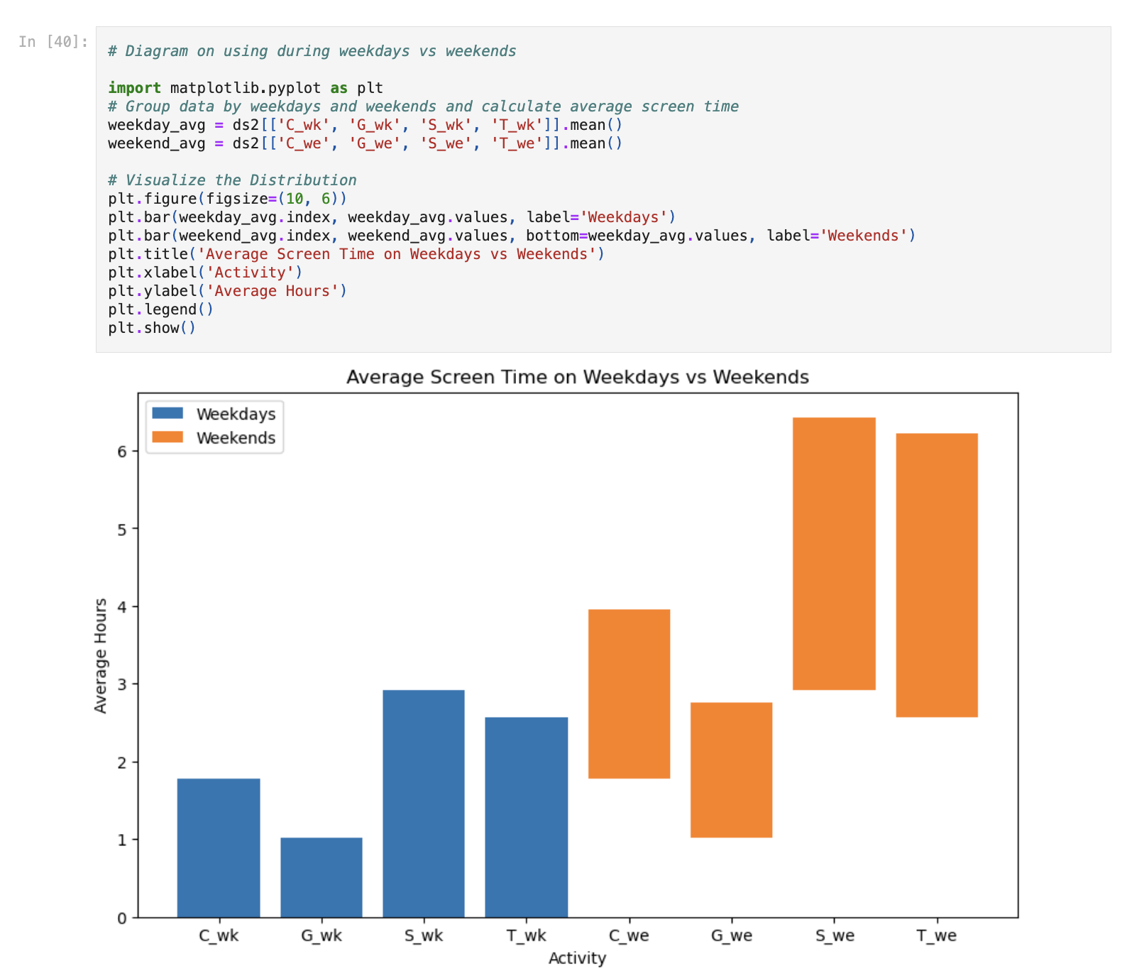

Slide 13
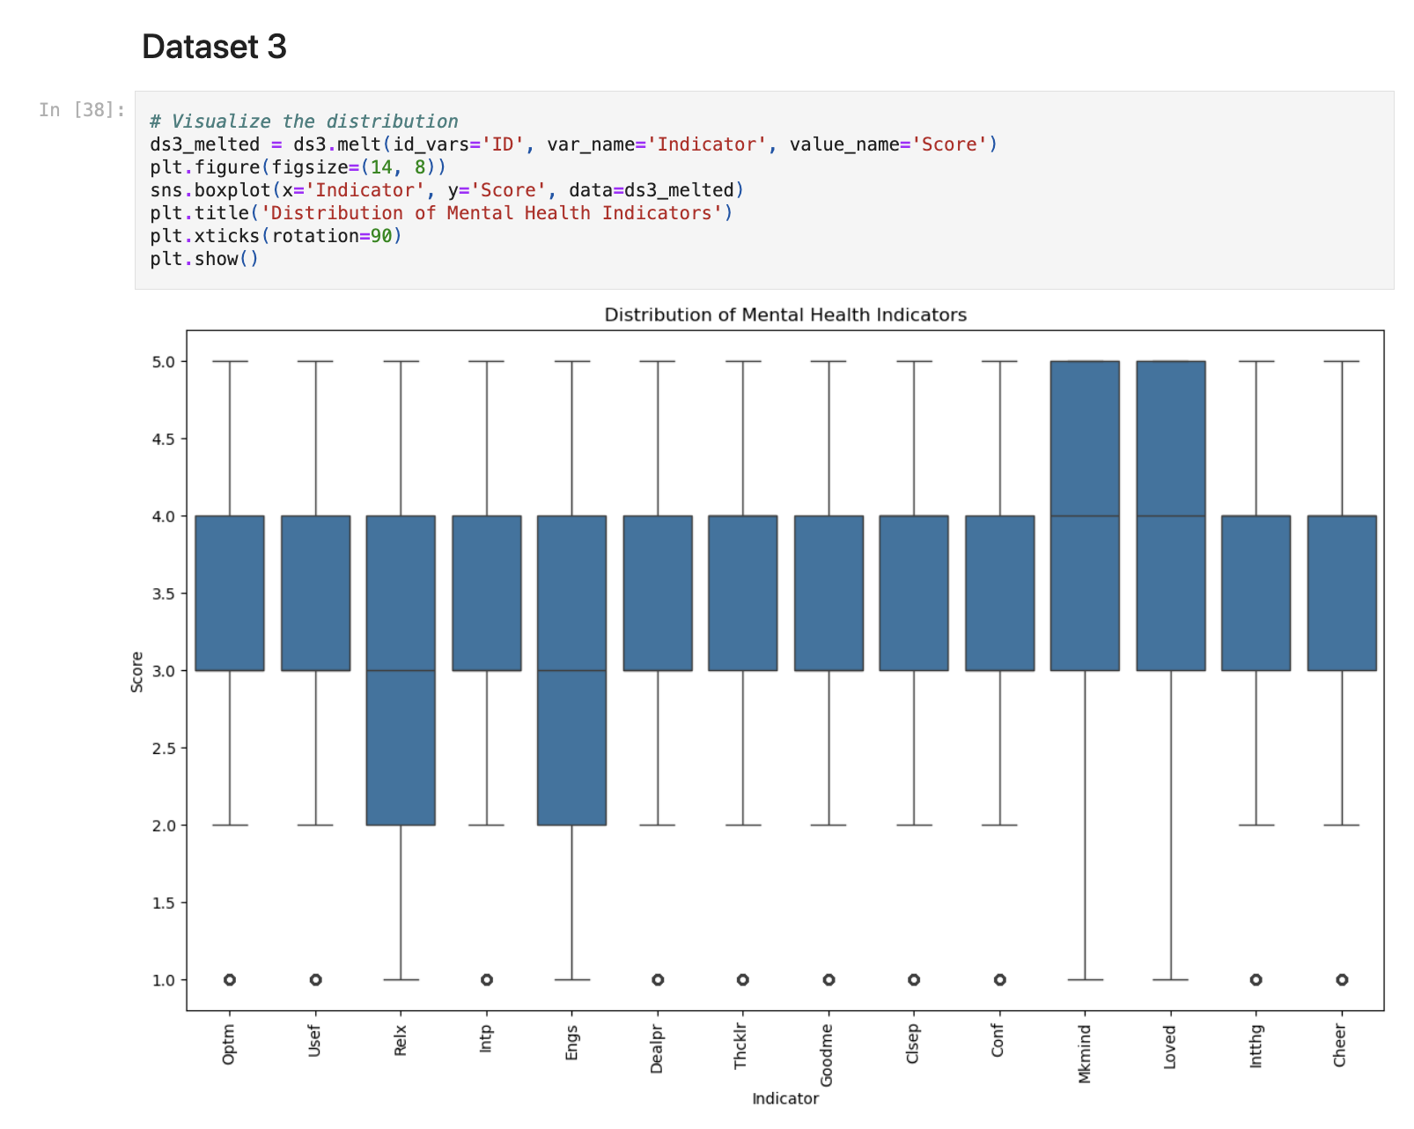

Slide 14
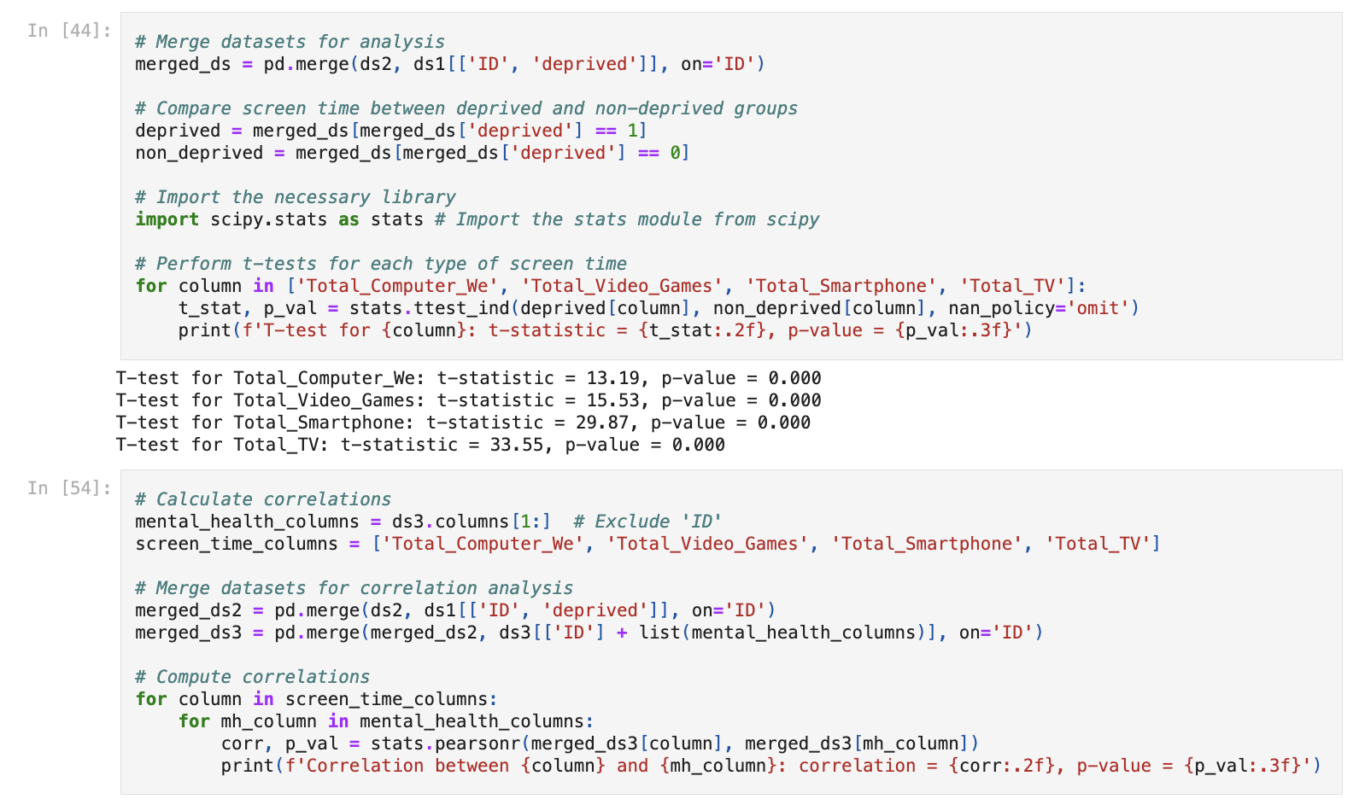
Inferential Statistical Analysis

Slide 15
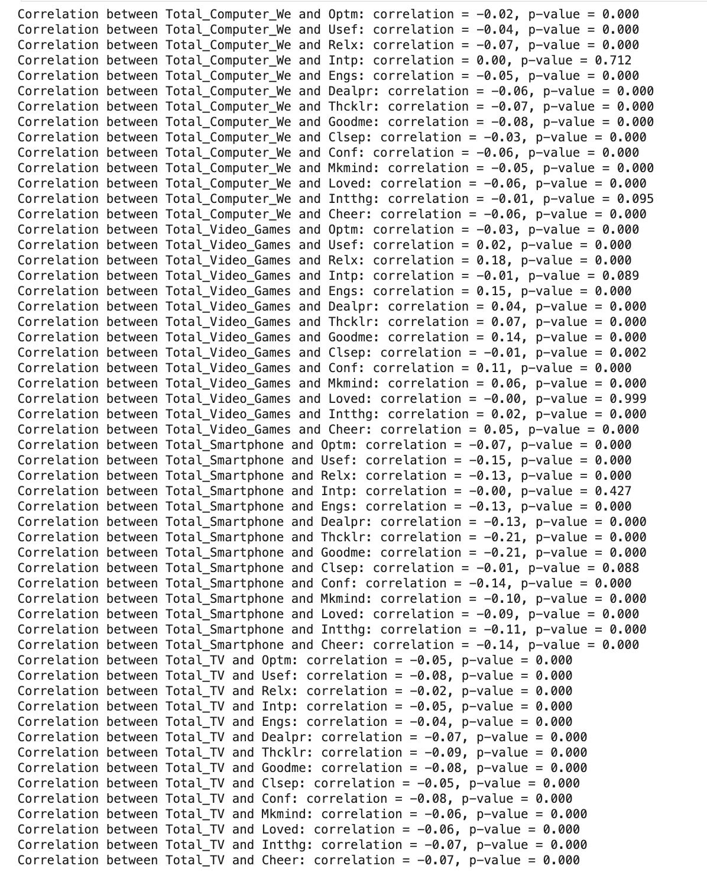

Slide 16
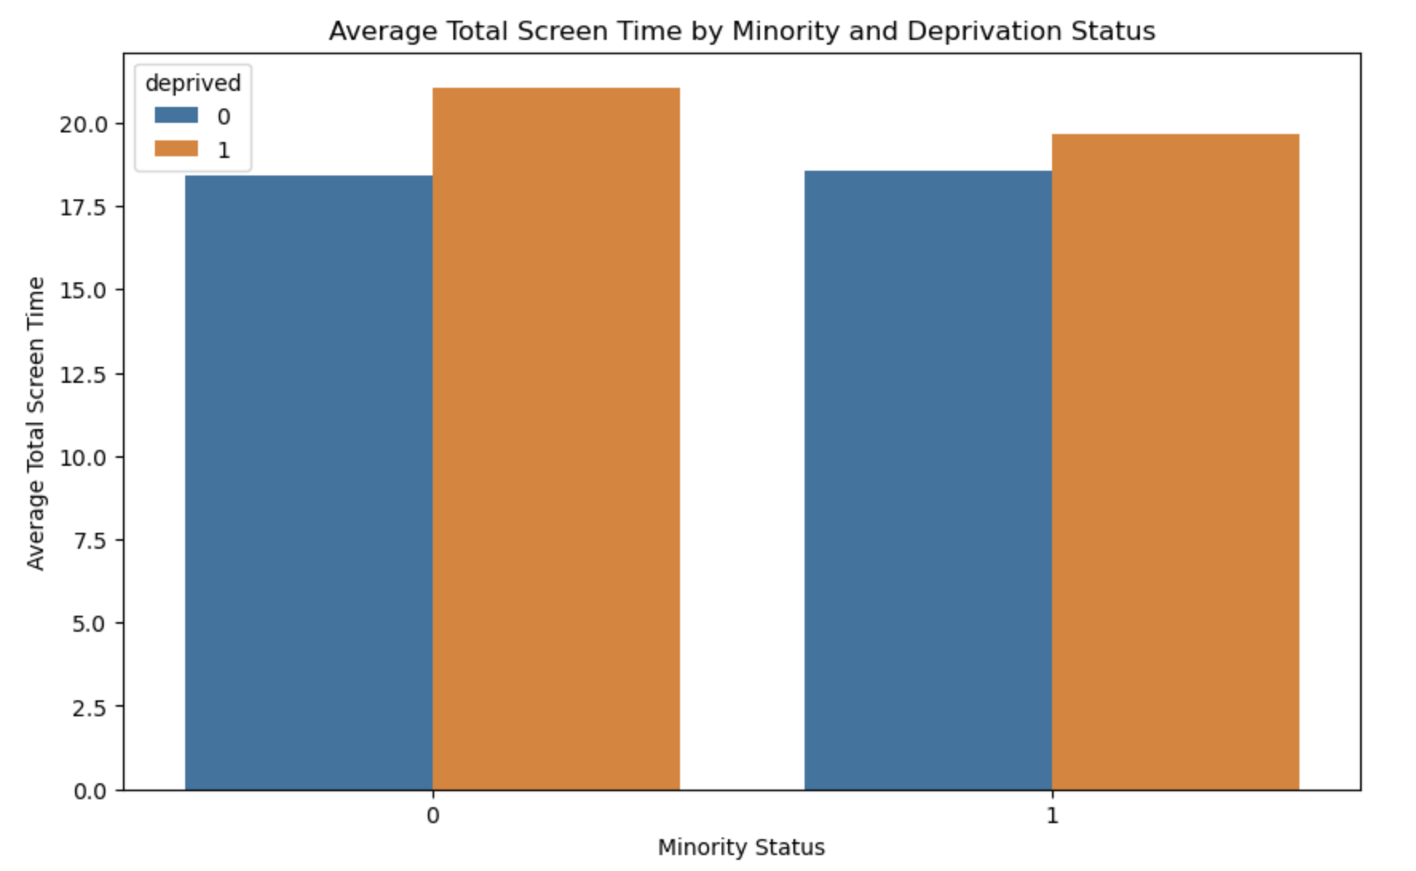
Relation Between DataSets
We combined data from two datasets to calculate each person's total screen time by adding their device usage for weekdays and weekends. Then, we merged this with information about whether they were part of a minority group or deprived background. After grouping the data by these factors, we found the average screen time for each group. Lastly, we created a bar plot to show how screen time varies based on minority and deprivation status.

Slide 17
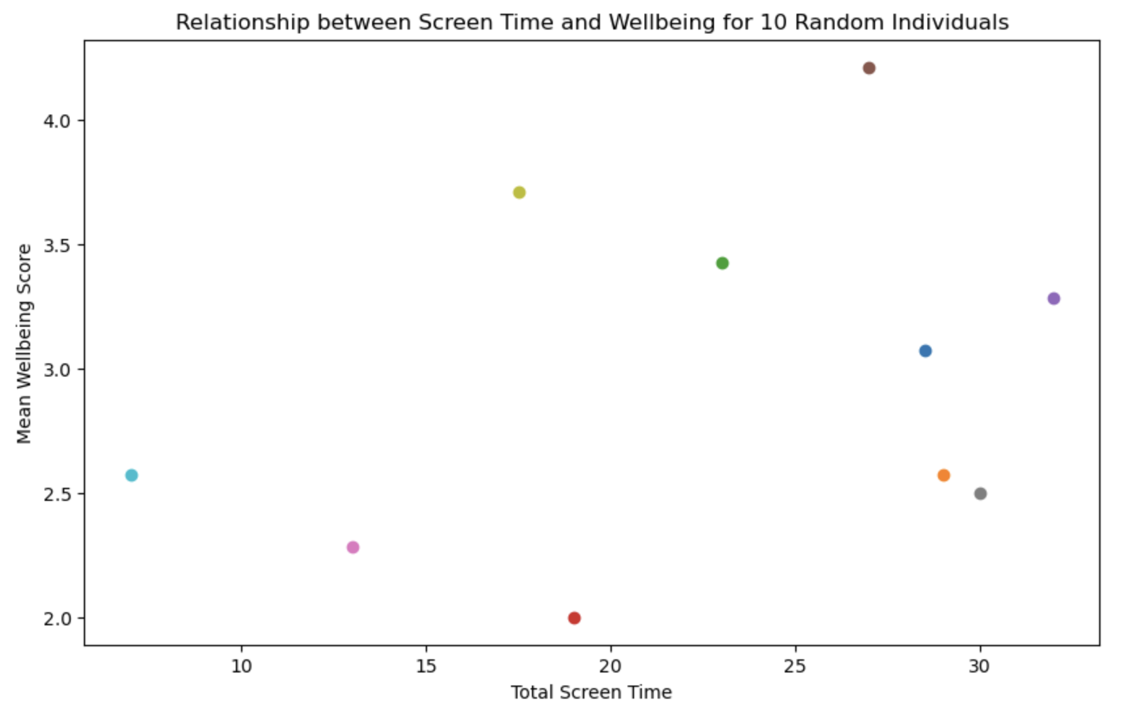
Relation Between DataSets
We calculated the total screen time for each individual by summing their screen usage across various devices from weekdays and weekends. Similarly, we computed the mean wellbeing score by averaging multiple wellbeing-related factors. The data from both datasets was merged, and a random sample of 10 individuals was selected. Finally, we plotted the relationship between total screen time and mean wellbeing for these 10 individuals to visually analyze the connection between these two variables.

Slide 18
CONCLUSION
The gender distribution is relatively balanced.
Individuals from minority and disadvantaged backgrounds tend to spend more time on screens.
People generally spend more time on smartphones and TV, though we will calculate the average screen time for both weekdays and weekends.
Average screen time has a direct impact on an individual's wellbeing, with lower screen time correlating to higher wellbeing.
By comparing screen time and wellbeing, we can assess an individual's overall condition.
Applying a regression model allows us to determine the accuracy of the dataset.

Slide 19
THANK YOU

